Slide 1
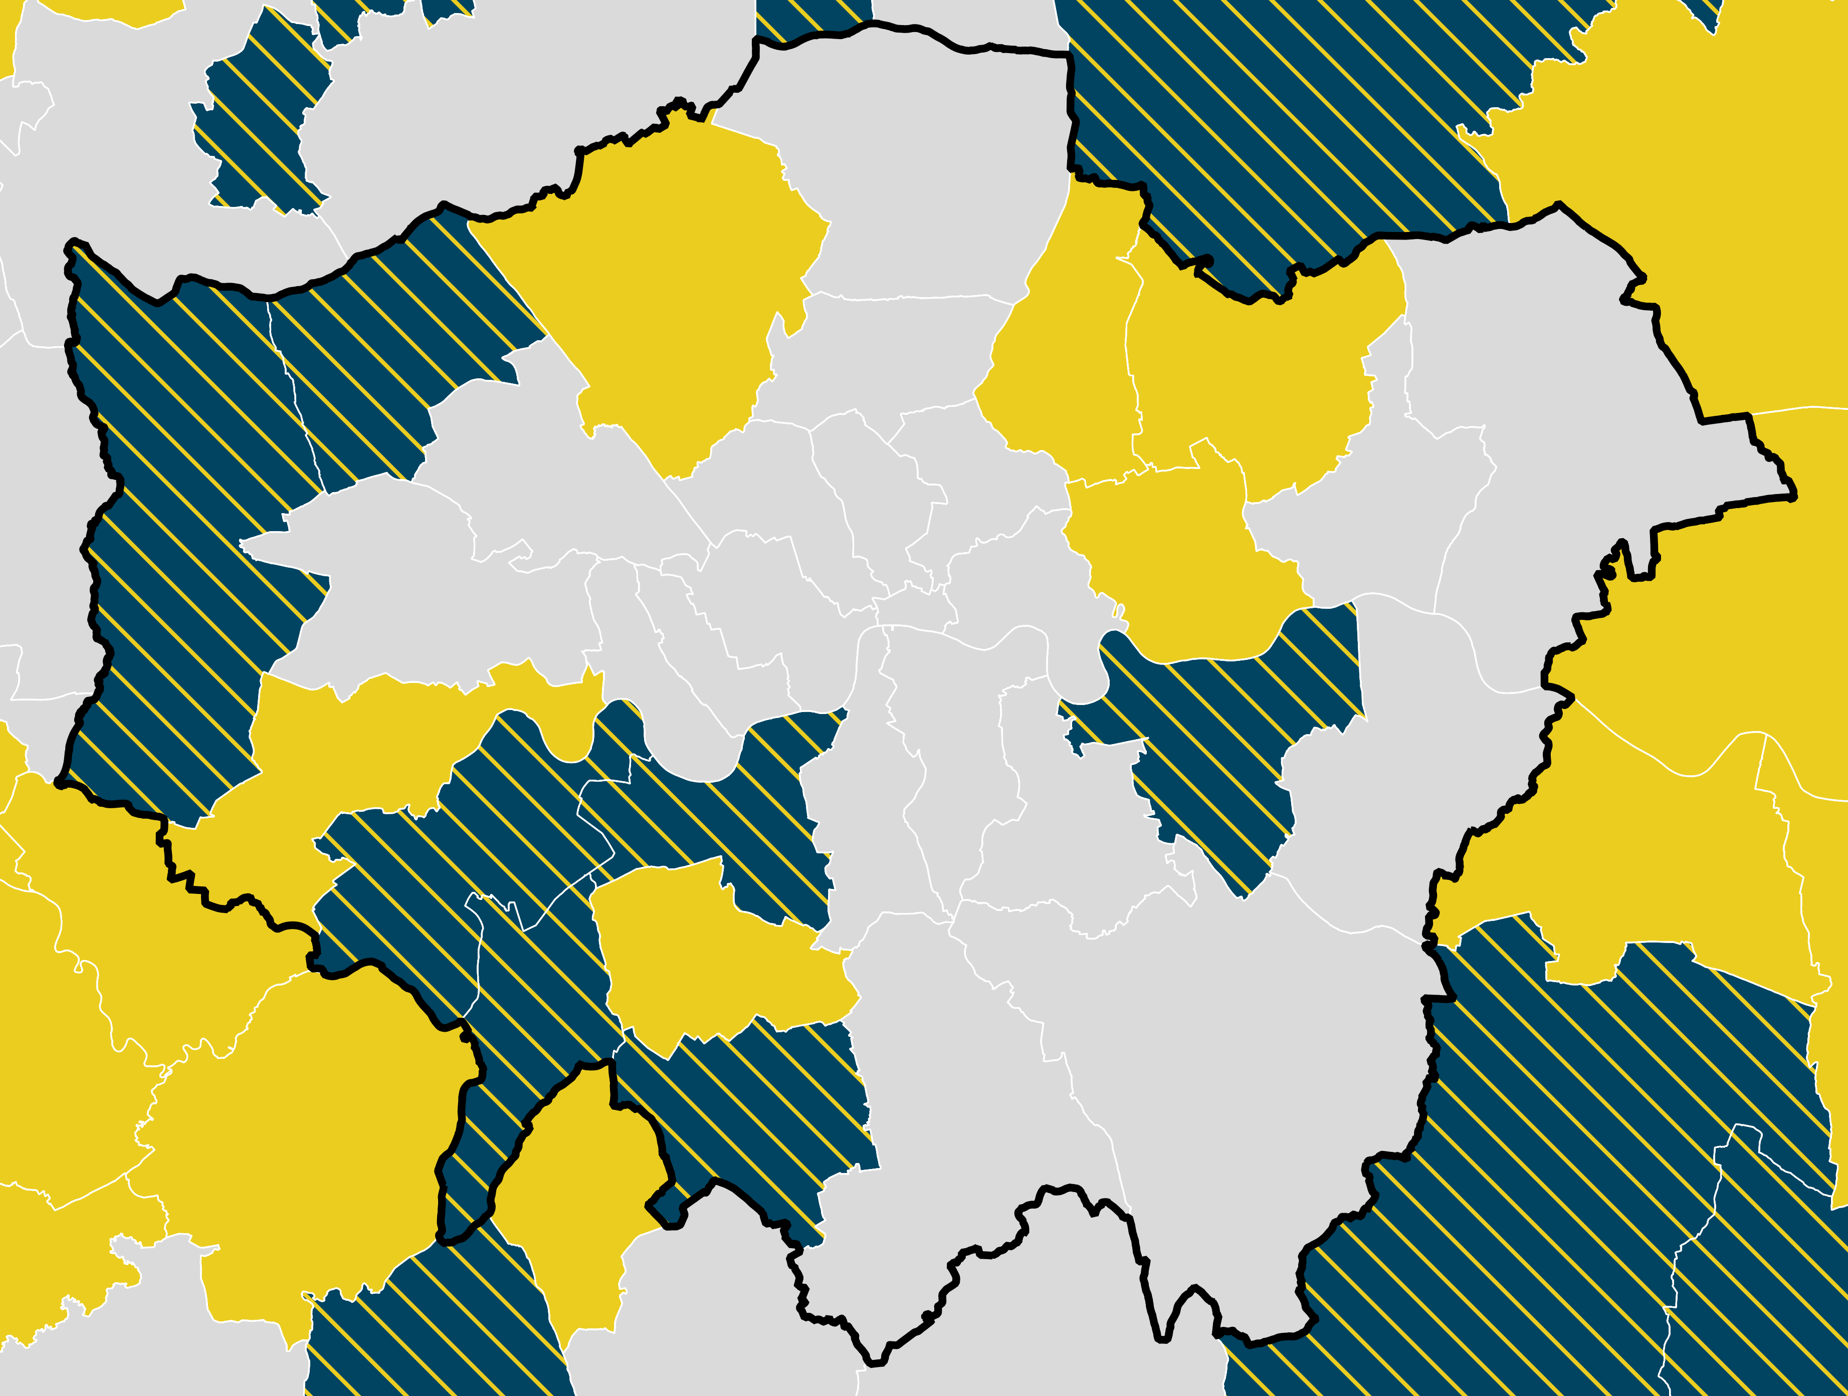
London
Winners of the Gold Performance Award and Gold Achievement Award for Address Data 2019

Slide 2
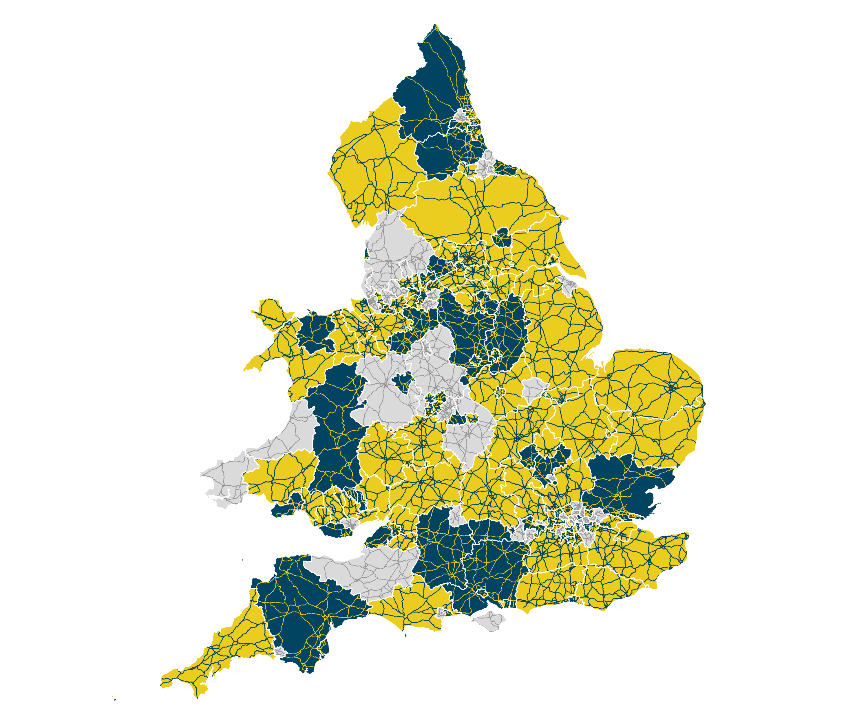
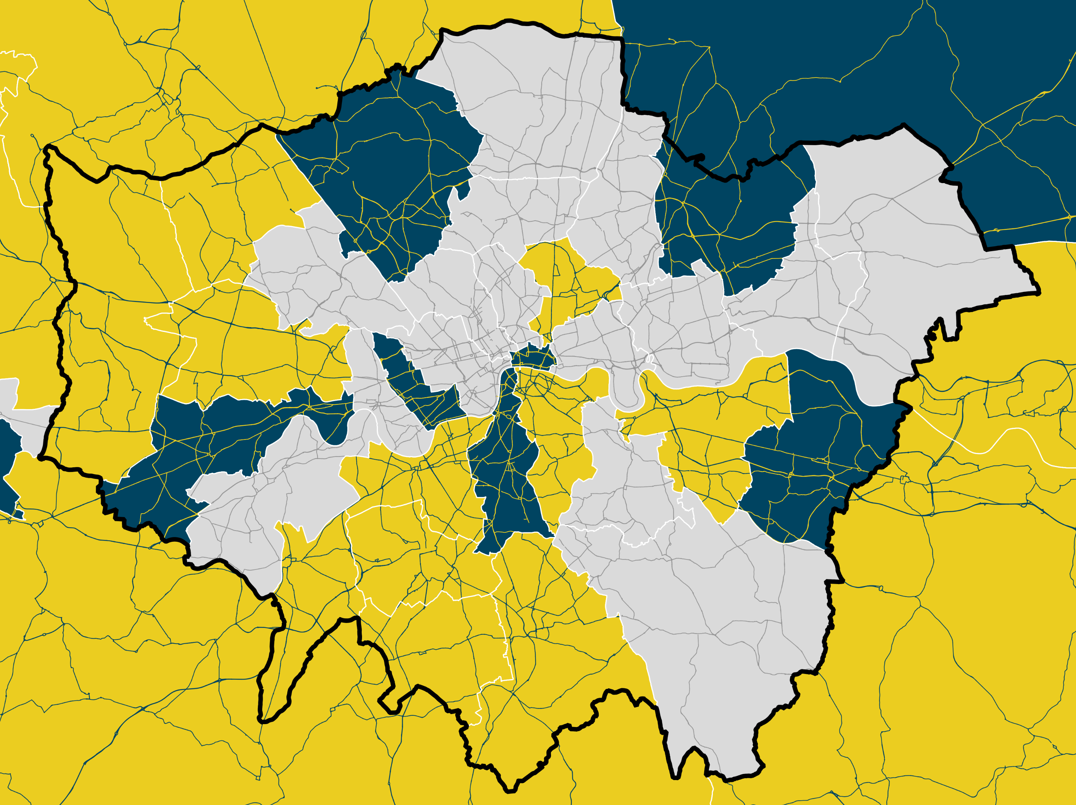
London
Winners of the Gold Performance Award and Gold Achievement Award for Street Data 2019

